Slide 1


BMB3015 ARTIFICIAL INTELLIGENCE
INFORMED SEARCH

Slide 2
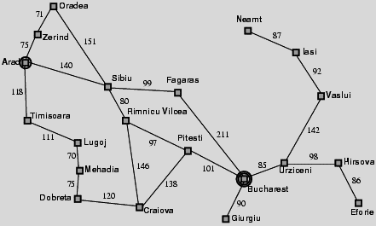
Holiday in Romania Problem

Slide 3
Online versus Offline Search
Tree search is an offline problem solving method
solution executed with eyes closed.
Online problem solving involves acting without complete knowledge.

Slide 4
Informed Search Methods
Use information about the domain to get directed to the goal
Also known as heuristics-based search methods
Informed search
Best-first search
Greedy best-first search
A* search
Local search
Hill climbing
Simulated annealing
Local beam search
Genetic algorithms

Slide 5
Dynamic Programming
Evaluates current cost of the state and uses some heuristics to reach the goal state.
General strategy is to expand the node with the best evaluation value or the least cost.
Decisions at each time step depend on the solution to the previous subproblems.
Final solution is obtained using backtracing.
Alleviates exponential complexities of uninformed search algorithms.

Slide 6
Best-First Search
Idea: use an evaluation function f(n) for each node
estimate of "desirability"
expand most desirable unexpanded node
Implementation:
Order the nodes in fringe in decreasing order of desirability
Special cases
Greedy best-first search
A* search

Slide 7
Evaluation Function f(n)
Remember uniform cost search (UCS)
f(n) = g(n)
f(n) is evaluation function
to decide which node to expand next
g(n) is cost function
gives the path cost up to node n
Greedy best-first search
f(n) = h(n)
h(n) is heuristic function
gives estimated cost from node n to goal
A* search
f(n) = g(n) + h(n)

Slide 8
Estimate of Goal Distance

Slide 9
Heuristics
Heuristics (heuristic rules, heuristic methods)
strictly restricts the search of a solution using a rule, strategy, trick, simplification, or another element
when state-space of a problem is very large.
«Fagenbaum and Fieldman»
Properties of a good heuristic function
never overestimates (abartmayan)
optimistic (iyimser)
admissible (makul)
Notes:
Sezgisellik (sezgisel kurallar, sezgisel yöntem) problemin durum uzayı çok büyük olduğunda, çözümün aranmasını kesin biçimde sınırlayan herhangi bir kural, strateji, hile, sadeleştirme ve diğer etmenlerin kullanımıdır. (Fagenbaum ve Fieldman)

Slide 10
Heuristic Function vs Cost Function
Heuristic function is not additive as g(n)
Must be estimated separately for each node state
Trying to minimize g(n)
keeps the path short
Trying to minimize h(n)
focuses on the goal
If h(n)< true cost, then A* can find the optimal path.

Slide 11
Greedy Best-First Search
Expands the node that appears to be closest to the goal
Evaluation function is the heuristic function
f(n) = h(n)
means estimate of cost from n to goal
For holiday in Romania problem,
e.g., h (n) = straight-line distance from n to Bucharest

Slide 12
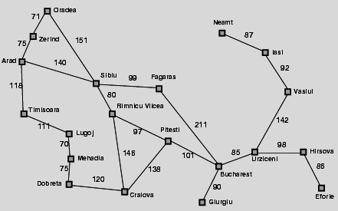
Romania with Straight-Line Distances
Straight-line distances to Bucharest
Arad | 366
Bucharest | 0
Craiova | 160
Dobreta | 242
Eforie | 161
Fagaras | 176
Giurgiu | 77
Hirsova | 151
Iasi | 226
Lugoj | 244
Mehadia | 241
Neamt | 234
Oradea | 380
Pitesti | 100
Rimnicu Vilcea | 193
Sibiu | 253
Timisoara | 329
Urziceni | 80
Vaslui | 199
Zerind | 374
h(n) is the straight line distance between a city and the Bucharest

Slide 13
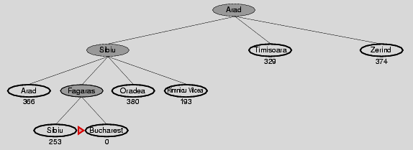

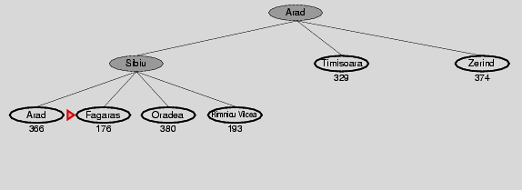
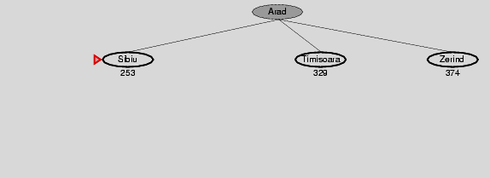
Holiday in Romania: Greedy Best-First Search
Optimal solution
Greedy best first search solution

Slide 14
Greedy Best-First Search
Complete? No – can get stuck in loops,
Resembles DFS since it prefers to follow a single path on the way to the goal
e.g., Iasi to Fagaras problem:
Iasi → Neamt → Iasi → Neamt → …
Complete in finite space with repeated-state checking
Time? O(b^{m})
but a good heuristic can give dramatic improvement
Space? O(b^{m}), keeps all nodes in memory
Optimal? No

Slide 15
A* Search
Idea:
avoid expanding paths that are already expensive
Evaluation function f(n) = g(n) + h(n)
g(n) = cost so far to reach n
h(n) = estimated cost from n to goal
f(n) = estimated total cost of path through n to goal

Slide 16
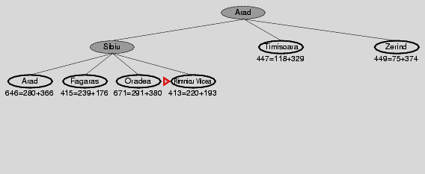
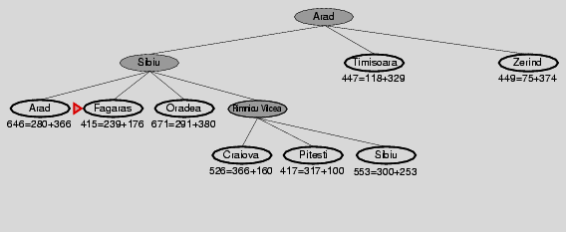
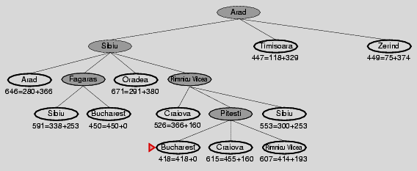
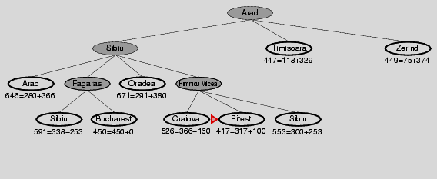
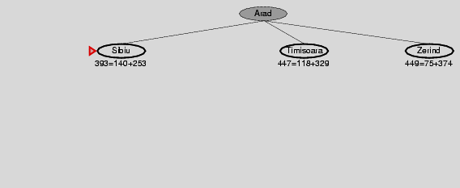

Holiday in Romania: A* search
Optimal solution

Slide 17
A* Search
Complete? Yes
unless there are infinitely many nodes with f ≤ f(G)
Time? Exponential
Space? Keeps all nodes in memory Optimal? Yes, cannot expand f_{i+1} until f_{i} is finished
If C* is the cost of the optimal solution
A* expands all nodes with f(n) < C*
A* expands some nodes with f(n) = C*
A* expands no nodes with f(n) > C*

Slide 18
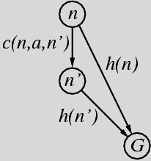
Consistent Heuristics
A heuristic is consistent if for every node n, every successor n' of n generated by any action a,
h(n) ≤ c(n,a,n') + h(n')
If h is consistent, we have
[f(n') = g(n') + h(n') = g(n) + c(n,a,n') + h(n') ]
≥ [g(n) + h(n) = f(n)]
i.e., f(n) is non-decreasing along any path.
Theorem: If h(n) is consistent,
A* using GRAPH-SEARCH is optimal

Slide 19
Admissible Heuristics
A heuristic h(n) is admissible if for every node n,
h(n) ≤ h*(n)
where h*(n) is the true cost to reach the goal state from n
An admissible heuristic never overestimates the cost to reach the goal,
i.e., it is optimistic
For example, h(n) of straight line distance never overestimates the actual road distance

Slide 20
Dominance
If h₂(n) ≥ h₁(n) for all n (both admissible)
then h₂ dominates h₁
h₂ is better for search
Typical search costs (average number of nodes expanded):
d=12
Iterative Deepening Search (IDS) = 3,644,035 nodes A*(h₁) = 227 nodes A*(h₂) = 73 nodes
d=24
IDS = too many nodes A*(h₁) = 39,135 nodes A*(h₂) = 1,641 nodes

Slide 21
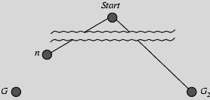
Optimality of A*
Suppose some suboptimal goal G₂ has been generated and is in the fringe.
Let n be an unexpanded node in the fringe such that n is on a shortest path to an optimal goal G.
f(G₂) = g(G₂) since h(G₂) = 0
f(G) = g(G) since h(G) = 0
g(G₂) > g(G) since G₂ is suboptimal
f(G₂) > f(G) since G₂ is suboptimal

Slide 22
Optimality of A*
Suppose some suboptimal goal G₂ has been generated and is in the fringe.
Let n be an unexpanded node in the fringe such that n is on a shortest path to an optimal goal G.
f(G₂) > f(G) since G₂ is suboptimal
h(n) ≤ h*(n) since h is admissible
g(n) + h(n) ≤ g(n) + h*(n)
f(n) ≤ f(G)
Hence f(G₂) > f(n), and A* will never select G₂ for expansion
Notes:
h*(n) = true cost of getting from n to goal

Slide 23
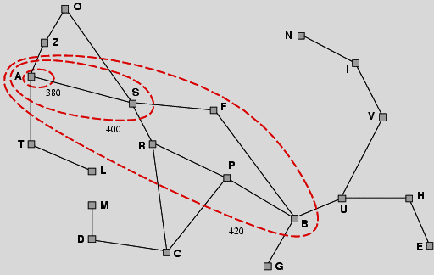
Optimality of A*
A* expands nodes in the order of increasing f value
Gradually adds "f-contours" of nodes
Contour i has all nodes with f=f_{i} , where f_{i} < f_{i+1}

Slide 24
Relaxed Problems
A problem with fewer restrictions on the actions is called a relaxed problem
The cost of an optimal solution to a relaxed problem is an admissible heuristic for the original problem
How to obtain a good heuristic function?
Define the rules of a problem
Cross out the part of the rules and define a relaxed problem
Find heuristics that never overestimate in this way
Notes:
• Key point: the optimal solution cost of a relaxed problem is no greater than the optimal solution cost of the real problem

Slide 25
LOCAL SEARCH
In many optimization problems
the path to the goal is irrelevant
the goal state itself is the solution
State space = set of "complete" configurations
find optimal configuration, e.g. travelling salesman problem (TSP)
find configuration satisfying constraints, e.g. N-queens
In such cases, local search (iterative improvement) algorithms are useful
keep a single "current" state, try to improve it
Requires constant storage space
suitable for online as well as offline search

Slide 26
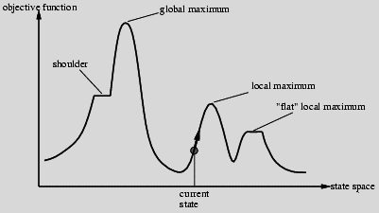
Hill-Climbing Search Problem
Depending on initial state, can get stuck in local maxima, i.e: foothill or plateau
Random restarts
Taking bigger steps
Therefore, point reached by hill-climbing may be maximal but not maximum.
Solutions?
Notes:
Local Optima (Foothill (Dağın uzantısı olan tepeler) Problem)
• Problem Definition
– Point reached by hill-climbing may be maximal but not maximum
– Maximal
• Definition: not dominated by any neighboring point (with respect to criterion measure)
– Maximum
• Definition: dominates all neighboring points (wrt criterion measure)
• Ramifications
– Steepest ascent hill-climbing will become trapped (why?)
– Need some way to break out of trap state
• Accept transition (i.e., search move) to dominated neighbor
• Start over: random restarts
Lack of Gradient (Plateau Problem)
• Problem Definition
– Function space may contain points whose neighbors are indistinguishable (with respect to criterion measure)
– Effect: “flat” search landscape
• Ramifications
– Steepest ascent hill-climbing will become trapped
– Need some way to break out of zero gradient
• Accept transition (i.e., search move) to random neighbor
• Random restarts
• Take bigger steps

Slide 27
Tabu Search
Tabu search
prevents returning quickly to the same state.
Implementation
keep fixed length queue so-called «tabu list»
add most recent state to queue
drop the oldest state
Never move to a state that's currently on the tabu list.
A significant cost can be added to f(n) of the visited states
Quite powerful
competitive with simulated annealing

Slide 28
Local Beam Search
Idea is to keep track of k states rather than just one
Start with k randomly generated states
At each iteration, the successors of all k states are generated
If any one is a goal state, stop;
Else select the k best successors from the complete list and repeat.
Notes:
Ana Fikir: Tek bir durumu izlemek yerine K taneyi izle
K adet rasgele üretilmiş durumla başla
Her bir iterasyonda k durumun hepsiden gidilebilecek tüm durumları üret.
Bu durumlardan biri hedefse dur. Değilse, en iyi k tanesini mevcut durumlar olarak ata ve bir önceki adıma dön.
Idea: keep k states instead of 1; choose top k of all their successors
Not the same as k searches run in parallel!
Searches that nd good states recruit other searches to join them
Problem: quite often, all k states end up on same local hill
Idea: choose k successors randomly, biased towards good ones
Observe the close analogy to natural selection!

Slide 29
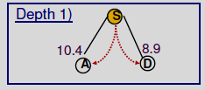
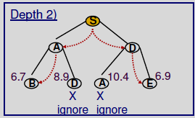
Local Beam Search
• Assume a pre-fixed width
in the example b= 2
• Perform breadthfirst, but only keep the width number of best new nodes depending on heuristic at each new level

Slide 30
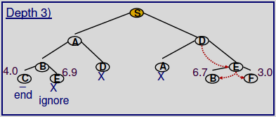
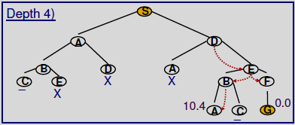
Local Beam Search
• Optimization is possible
Ignore leafs that are not goal nodes
see the node C

Slide 31
Genetic Algorithms
A successor state is generated by combining two parent states
Start with k randomly generated states (population)
A state (chromosome) is represented as a string over a finite alphabet (often a string of 0s and 1s)
Evaluation function (fitness function).
Higher values for better states.
Notes:
Genetik algoritmalar, evrim mekanizmasına (en iyinin yaşaması) dayanır.
Amaç, uygunluk fonksiyonunun (fitness function) maksimizasyon / minimizasyon optimizasyonudur.
Uygunluk fonksiyonu: Toplumdaki her kromozomun / birey / durum ne kadar iyi olduğu gösteren fonksiyondur. Büyük değer, iyi / uygun birey.
K adet rasgele üretilmiş kromozom / durum / çözüm hipotezi ile başlar. Durumlar kümesine popülasyon denir.
Kromozom / durumlar sırala ya da sırasız karakter kümeleri ile temsil edilir. Genelde sayılar ya da 0 ve 1’lardan oluşur.

Slide 32
Genetic Algorithm
Operations used to produce new chromosomes or states
selection:
Selection of chromosomes that are to be used to produce the next generation
reproduce:
Performance of crossover operation to generate new solutions
mutation:
Random change of some values of chromosomes
Notes:
Seçme (selection) :
Bir sonraki nesli üretecek kromozomların seçilmesidir.
Yeniden kopyalama (reproduce) :
Yeni çözümler üretmek için çaprazlama (crossover) işlemi yapılır.
Değiştirme (mutation) :
Kromozom’un bazı değerlerini rasgele değiştirir.

Slide 33
Ways of Chromosome Selection I: Roulette Wheel Selection
Chromosomes are selected according to their fitness values.
The chromosome with the greatest fitness values
has only the greatest probability for being selected
but its selection is not guaranteed.
The selection probability of each chromosome is
the ratio of its fitness value to the sum of fitness values of all chromosomes in the population.
Notes:
Farklı Olasılıklarla Seçim?
Seçilme şansları toplamı=100
Bir aralığı 100 parçaya böl.
Seçilme şanslarına göre parçaları kromozomlara ata.
1-100 arasında rasgele bir sayı üret.
O sayının karşı geldiği aralığın atandığı kromozomu seç.
Seçilme şansları %44.34355 şeklinde olursa?

Slide 34
Problems of Roulette Wheel Selection
Roulette wheel selection leads to problems when fitness values are fairly different.
For example,
if the selection probability of the best chromosome is 90%
the other chromosomes have much less chance for being selected.
Notes:
Farklı Olasılıklarla Seçim?
Seçilme şansları toplamı=100
Bir aralığı 100 parçaya böl.
Seçilme şanslarına göre parçaları kromozomlara ata.
1-100 arasında rasgele bir sayı üret.
O sayının karşı geldiği aralığın atandığı kromozomu seç.
Seçilme şansları %44.34355 şeklinde olursa?

Slide 35
Ways of Chromosome Selection II: Ordered Selection
Ordered selection first sorts the population according to the fitness values in ascending order.
The order value of the chromosome is assigned as the fitness value, which is 1 and N in the worst and best cases, respectively.
Selection probability is again the ratio of a fitness value to the total fitness values in the population.
Therefore all chromosomes have the chance of being selected.
Notes:
Farklı Olasılıklarla Seçim?
Seçilme şansları toplamı=100
Bir aralığı 100 parçaya böl.
Seçilme şanslarına göre parçaları kromozomlara ata.
1-100 arasında rasgele bir sayı üret.
O sayının karşı geldiği aralığın atandığı kromozomu seç.
Seçilme şansları %44.34355 şeklinde olursa?

Slide 36
Problems of Ordered Selection
The convergence of the method to the solution would be slow.
Because the selection probability of the best chromosomes are not much different than the others.
Notes:
Farklı Olasılıklarla Seçim?
Seçilme şansları toplamı=100
Bir aralığı 100 parçaya böl.
Seçilme şanslarına göre parçaları kromozomlara ata.
1-100 arasında rasgele bir sayı üret.
O sayının karşı geldiği aralığın atandığı kromozomu seç.
Seçilme şansları %44.34355 şeklinde olursa?

Slide 37
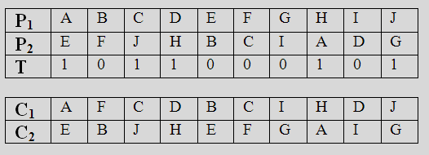
Uniform Crossover
Construct a template from random 1’s and 0’s at the length of a chromosome.
Change the locations of P1 and P2 for 0’s in the template.
Do not change the locations of P1 and P2 for 1’s in the template.
Cannot solve TSP problem

Slide 38
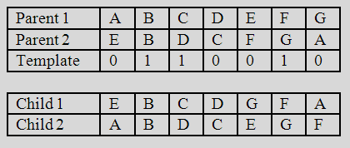
Order-based Crossover
Construct a template from random 1’s and 0’s at the length of a chromosome.
For Child1:
Take the values in Parent1 for which the indices in Template is 1. Put them at the same indices in Child1. Child1 has some spaces then.
Take the values in Parent1 for which the indices in Template is 0.
(A D E G)
Reorder the list according to their order in Parent2.
(E D G A)
Fill in the spaces of Child1 with the resulting list.
For Child2 :
Apply the same procedure
(E C F A) → (A C E F)

Slide 39
Summary
Heuristic functions
estimate costs of shortest paths
good heuristics can dramatically reduce search cost
admissible heuristics can be derived from exact solution of relaxed problems
Best-first search
is a general search where the minimum-cost nodes (according to some measure) are expanded first.
Greedy search and A* search are examples of best-first search algorithms
Greedy search
uses minimal estimated cost h(n) to the goal state as measure.
This reduces the search time, but the algorithm is neither complete nor optimal.
A* search
combines uniform-cost search and greedy search: f(n) = g(n) + h(n).
A* handles state repetitions and h(n) never overestimates.
A* is complete, optimal and optimally efficient, but its space complexity is still bad.
The time complexity depends on the quality of the heuristic function.
Iterative deepening A* and Simplified memory bounded A* reduce the memory requirements of A*.
Local Search
Used when the path to the goal is irrelevant; but the goal state itself is the solution
Hill-climbing algorithms
keep only a single state in memory, but can get stuck on local optima.
Simulated annealing
escapes local optima, and is complete and optimal given a “long enough” cooling schedule.

